Slide 1

Transformer In Computer Vision
Jeonbuk National University
Software Engineering Lab
Shuli Xing
2021-08-13

Slide 2
Transformer Achievements
ImageNet Classification
Model Name | Accuracy | Parameter | Extra Training Data
ViT-G / 14 | 90.45 | 1843M | 
ViT-MoE-15B | 90.35 | 14700M | 
EfficientNet-L2 | 90.2 | 480M | 
EfficientNet-B6-Wide | 90 | 390M | 
COCO Detection
Model Name | bbox AP | Extra Training Data
DyHead | 60.6 | 
Dual- Swin -L | 60.1 | 
Focal-L | 58.9 | 
Swin-L | 58.7 | 
Semantic Segmentation (ADE20K)
Model Name | mIOU
BEiT-L (BERT) | 57.0
CSWin-L | 55.7
MaskFormer (Swin-L) | 55.6
Focal-L | 55.4
Action Classification (Kinetics-400)
Model Name | Vid acc@1 | Extra Training Data
Swin-L | 84.9 | 
ViViT-H/16x2 | 84.8 | 
OmniSource irCSN-152 | 83.6 | 
VATT-Large | 82.1 | 
Image Captioning
Action Detection
Fine-Grained Image Classification
……

Slide 3
Outline
Transformer: Attention Is All You Need
ViT: Vision Transformer
ViT Variants: DeepViT, Swin Transformer, BoT
My Thinking: How to apply Transformer in Computer Vision
Conclusion and Future Work
Reference

Slide 4
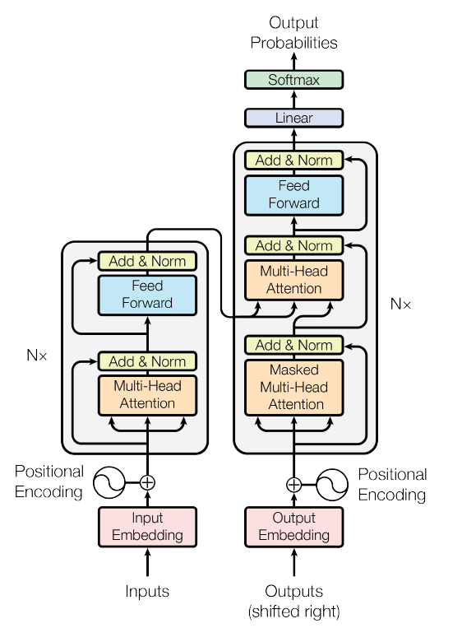
Transformer: Attention Is All You Need [1]
Position Encoding
Multi-Head Attention
Feed Forward Layers
Shortcut and Normalization Layers
Position Encoding:
“Since our model contains no recurrence and no convolution, in order for the model to make use of the order of the sequence, we must inject some information about the relative or absolute position of the tokens in the sequence.”
Decoder
Encoder
* Absolute distance
(0, 0) | (0, 1) (0, -1) | (0, 2) (0, -2)
(1, 0) (-1, 0) | (1, 1) (-1, -1) | (1, 2) (-1, -2)
(2, 0) (-2, 0) | (2, 1) (-2, -1) | (2, 2) (-2, -2)
* Pairwise relationships between input elements.
(0, 0) | (0, 1) | (0, 2)
(1, 0) | (1, 1) | (1, 2)
(2, 0) | (2, 1) | (2, 2)
Improved the expression of location information
(a)
(b)
Manual Function
Learnable parameters
Fig.2 Position encoding methods: (a) absolute position method; (b) relative position method.
Fig.1 Transformer: Model architecture

Slide 5
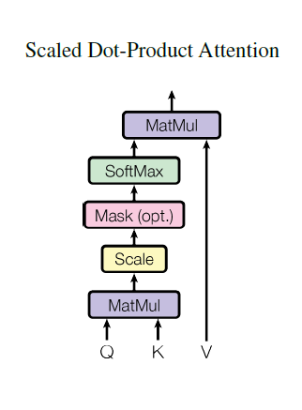
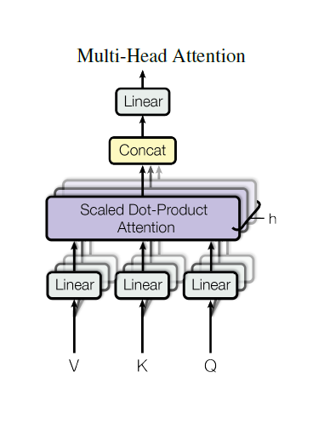


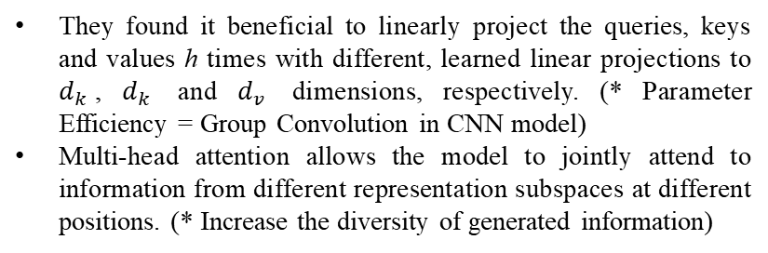
Transformer: Attention Is All You Need
Multi-Head Attention
Why do we need Multi-Head?
They found it beneficial to linearly project the queries, keys and values h times with different, learned linear projections to $d_{k}$, $d_{k}$ and $d_{v}$ dimensions, respectively. (* Parameter Efficiency = Group Convolution in CNN model)
Multi-head attention allows the model to jointly attend to information from different representation subspaces at different positions. (* Increase the diversity of generated information)
Split to
Fig. 3 (left) Scaled Dot-Product Attention. (right) Multi-Head Attention consists of several attention layers running in parallel.
Generate Q, K, and V
Q, K, V are split to Multi Heads
Implement Multi-Head Attention
Concatenate Multi Heads to Single Head

Slide 6
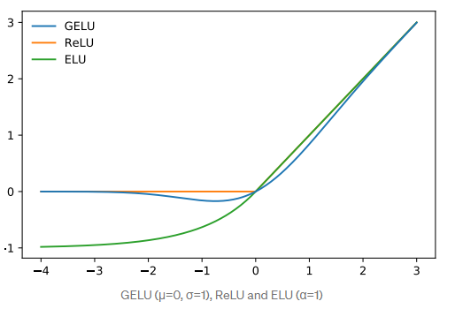

Transformer: Attention Is All You Need
Feed Forward Layers: Position-wise Feed-Forward Networks
“In addition to attention sub-layers, each of the layers in our encoder and decoder contains a fully connected feed-forward network, which is applied to each position separately and identically. This consists of two linear transformations with a ReLU activation in between.”
Cross Heads feature Fusion = Pointwise Convolution (“Another way of describing this is as two convolutions with kernel size 1”)
Increase Fusion complexity = two linear layers (Network in Network [2])
Shortcut and Normalization Layers
Shortcut: x + F(x) “Avoid vanishing gradient problem”
Normalization Layers = Batch Normalization Layer “Accelerate and stabilize Training Process”
Activation Function: GELU [3]

Slide 7
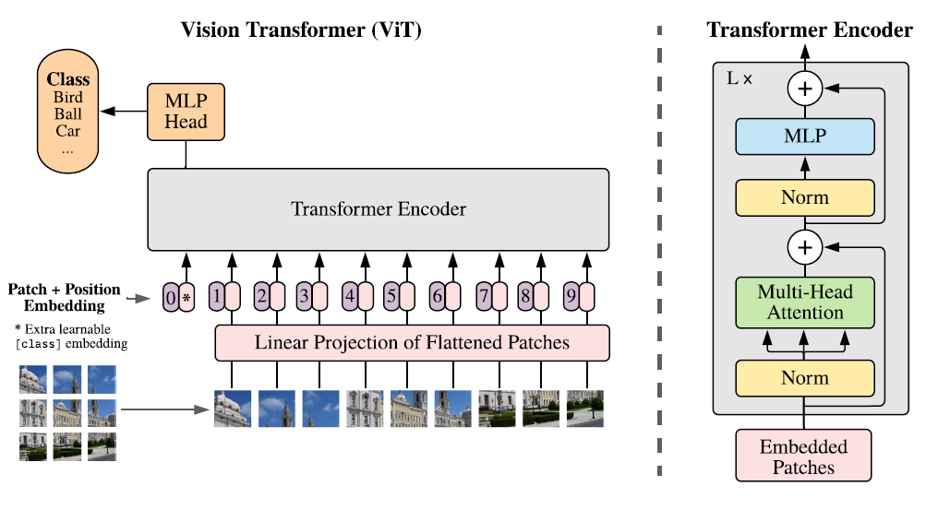
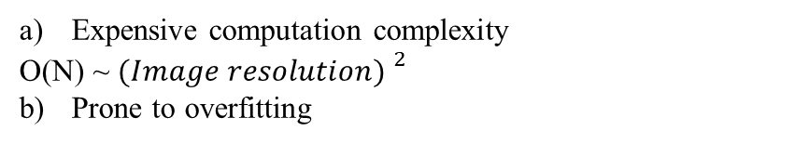
ViT: Vision Transformer [4]
224×224×3 = 64 * (28 ×28×3)
Cut images into many patches = tokens
Patch Projection: reduce computation cost
Patch + Position Embedding (extra Class Embedding)
Transformer calculation (Transformer Encoder)
512
explored the direct application of Transformers to image recognition. (First)
interpret an image as a sequence of patches and process it by a standard Transformer encoder as used in NLP. (New perspective)
This simple, yet scalable, strategy works surprisingly well when coupled with pre-training on large datasets. (Encouraging results)
Fig. 4 Model overview: “We split an image into fixed-size patches, linearly embed each of them, add position embeddings, and feed the resulting sequence of vectors to a standard Transformer encoder. In order to perform classification, we use the standard approach of adding an extra learnable “classification token” to the sequence.”
Expensive computation complexity
O(N) ~ ${(Image resolution) }^{2}$
Prone to overfitting

Slide 8
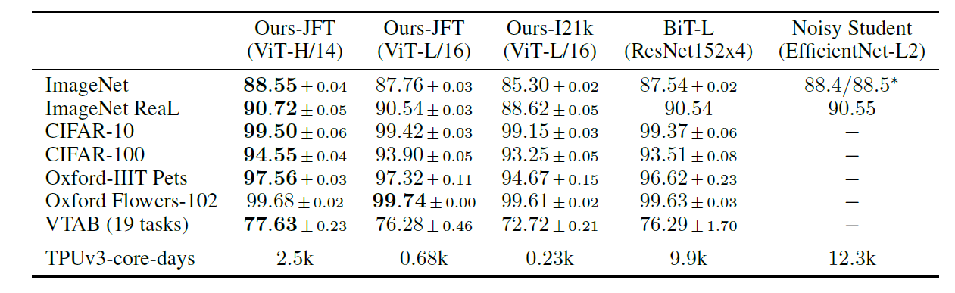
ViT: Vision Transformer
TPUv3 with 8 cores, around 30 days
Table 1: Comparison with state of the art on popular image classification benchmarks. We report mean and standard deviation of the accuracies, averaged over three fine-tuning runs. Vision Transformer models pre-trained on the JFT-300M dataset outperform ResNet-based baselines on all datasets, while taking substantially less computational resources to pre-train. ViT pre-trained on the smaller public ImageNet-21k dataset performs well too.
There are two main directions for the modification of Vision Transformer:
Based on Pure Transformer Architecture: Swin Transformer, Transformer In Transformer, etc.
Based on CNN Architecture: BoT, CoAtNet

Slide 9
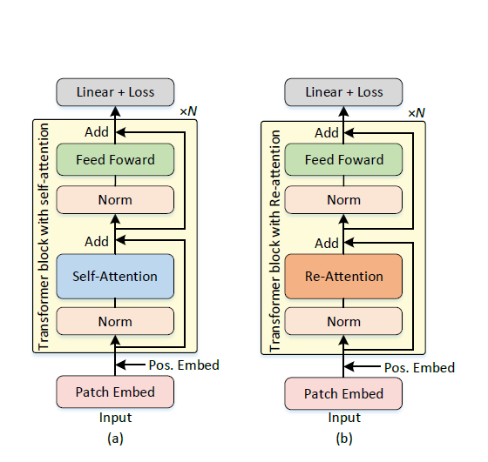
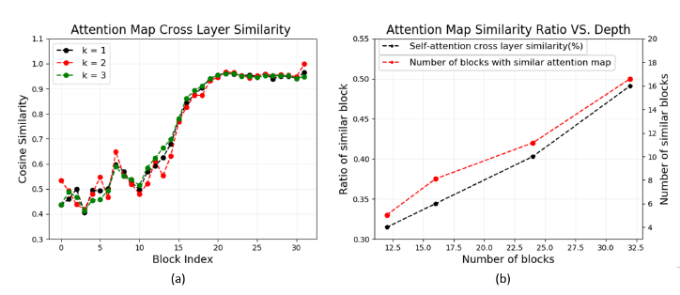
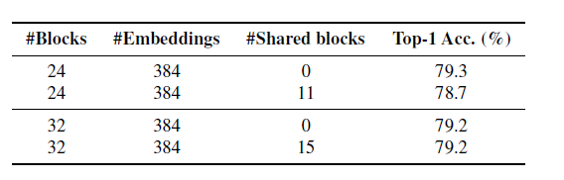
ViT Variants: DeepViT [5]
Problem: They observed that with the same dataset, the performance of vision transformers do saturate as the network depth rises.
Reason: As the transformer goes deeper, the attention maps gradually become similar and even much the same after certain layers. In other words, the feature maps tend to be identical in the top layers of deep ViT models. (Attention Collapse)
Fig. 5 Comparison between the (a) original ViT with N transformer blocks and (b) our proposed DeepViT model.
Fig.6 (a) The similarity ratio of the generated self-attention maps across different layers. (b) (b) The ratio of similar blocks to the total number of blocks increases when the depth of the ViT model increases.
Table 2: ImageNet top-1 accuracy of the ViT models with shared self-attention maps.
Notes:
nearest k transformer blocks

Slide 10
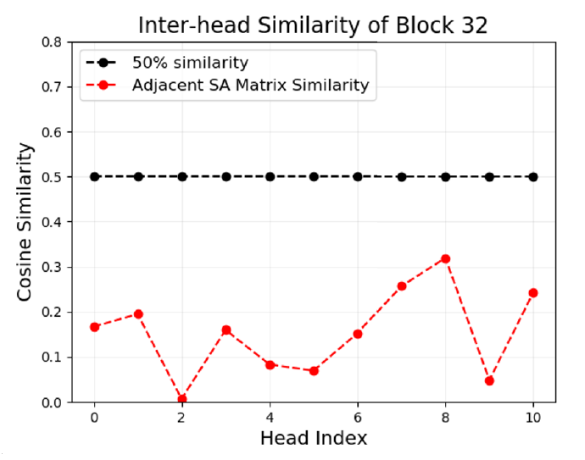

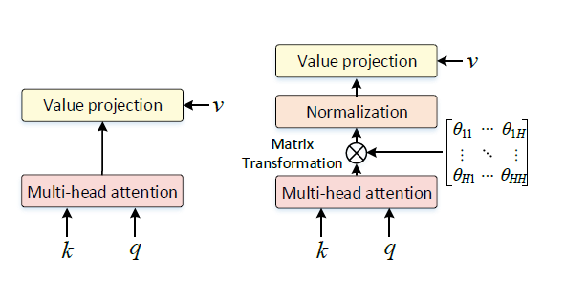

ViT Variants: DeepViT
Solution:
Although the similarity between attention maps across different transformer blocks is high, especially for deep layers, the similarity of attention maps from different heads of the same transformer block is quite small.
Based on this observation, they propose to establish cross-head communication to re-generate the attention maps and train deep ViTs to perform better.
To achieve this, they define a learnable transformation matrix and then use it to mix the multi-head attention maps into re-generated new ones, before being multiplied with V . Specifically, the Re-attention is implemented by:
Fig.7 Similarity of attention maps from different heads within the same block. The similarity between different heads within the blocks is all lower than 30% and they present sufficient diversity.
Transformation matrix
Matrix multiplication

Slide 11
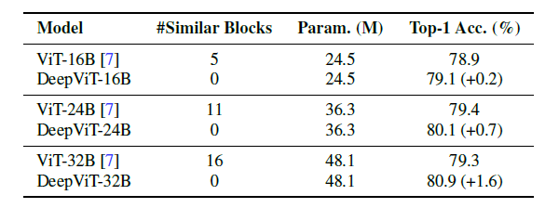
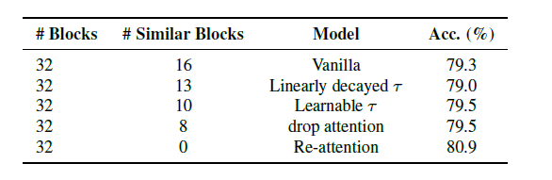
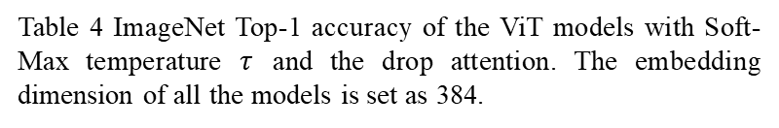
ViT Variants: DeepViT
Table 3 ImageNet Top-1 accuracy of deep ViT (DeepViT) models with Re-attention and different number of transformer blocks.
Table 4 ImageNet Top-1 accuracy of the ViT models with Soft-Max temperature $τ$ and the drop attention. The embedding dimension of all the models is set as 384.
Notes:
Softmax temperature: Distilling the Knowledge in a Neural Network. NIPS (2014).
drop attention: random dropout on the attention maps

Slide 12
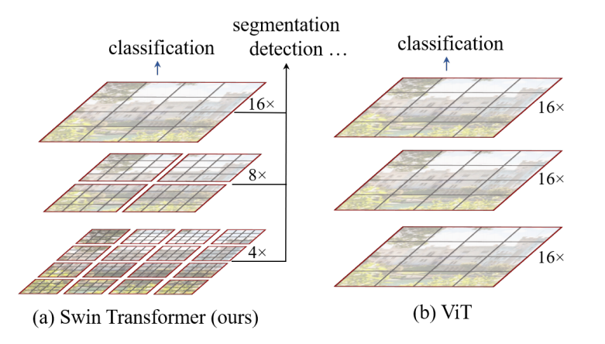
ViT Variants: Swin Transformer [6]
Challenges in adapting Transformer from language to vision arise from differences between the two domains, such as large variations in the scale of visual entities and the high resolution of pixels in images compared to words in text.
Patches with fixed window sizes is inefficient to adapt to the scale changes of target objects in images.
High resolution images consumed much more computing resources.
Fig. 8 (a) Swin Transformer (b) Original Vision Transformers.
Swin Transformer constructs a hierarchical representation by starting from small-sized patches (outlined in gray) and gradually merging neighboring patches in deeper Transformer layers.
Self-attention is computed in non-overlapping local windows (outlined in red), which allows Swin Transformer to have linear computational complexity with respect to image size.
A key design element of Swin Transformer is its shift of the window partition between consecutive self-attention layers, as illustrated in Figure 9.

Slide 13
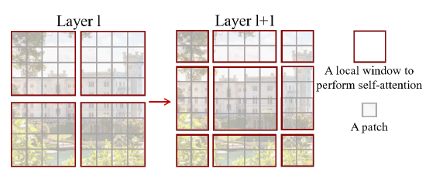
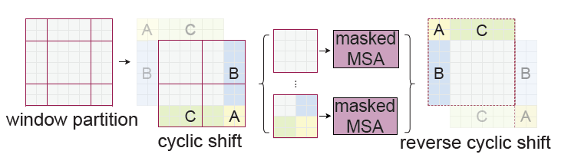
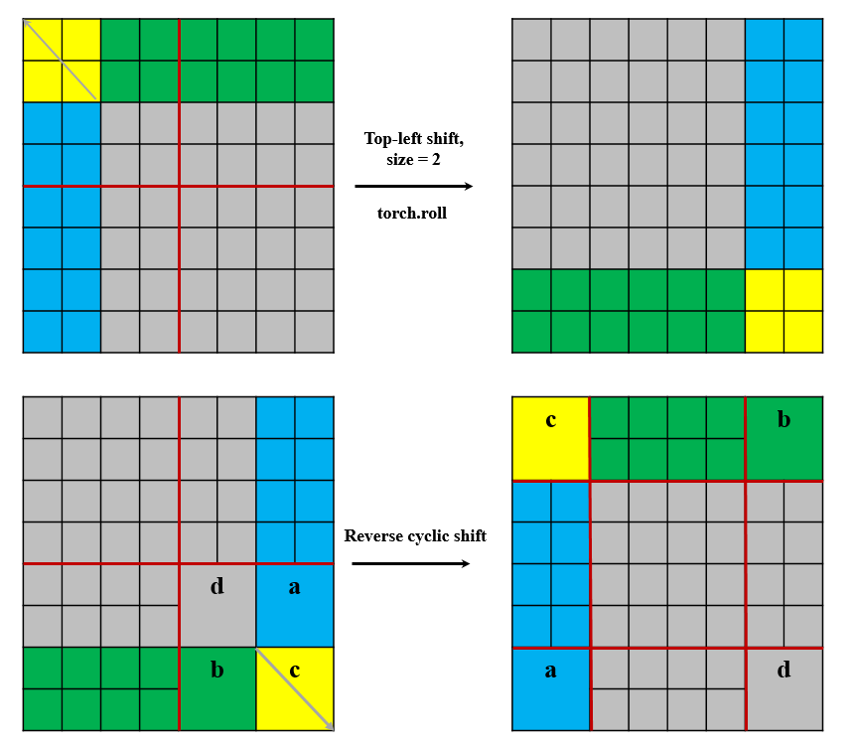
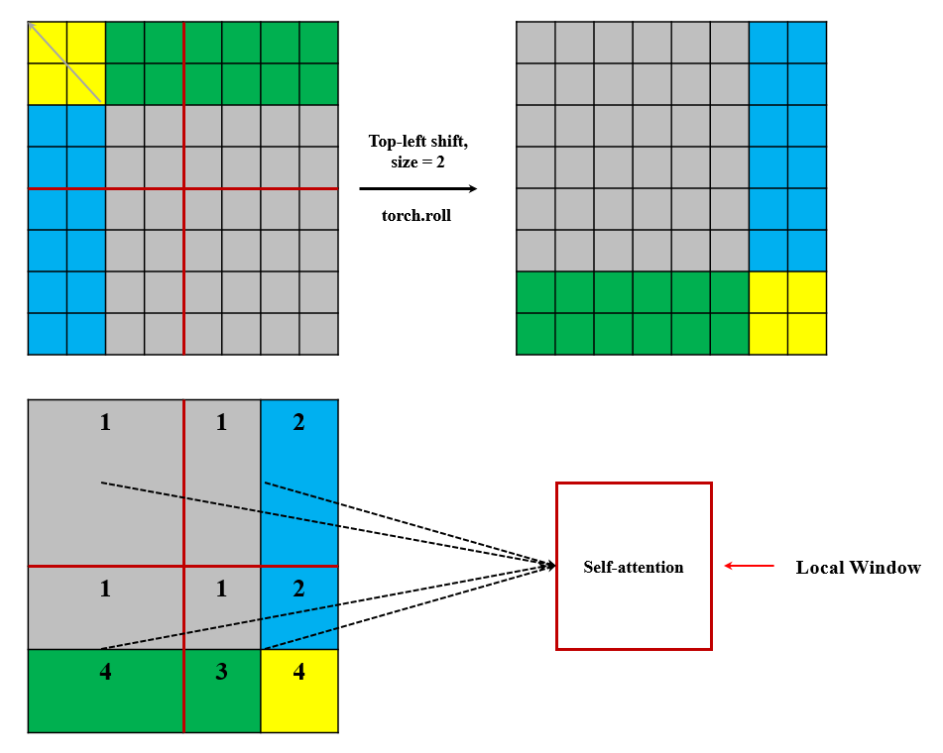
ViT Variants: Swin Transformer
Fig. 9 An illustration of the shifted window approach for computing self-attention in the proposed Swin Transformer architecture.
Fig. 10 Illustration of an efficient batch computation approach for self-attention in shifted window partitioning.
3

Slide 14

ViT Variants: Swin Transformer
Masked MSA :
 | 1 | 2
1 | 1 | 0
2 | 0 | 1
1 | 1 | 2
1 | 1 | 2
3 | 3 | 4
Relative Position Embedding method [8]
 | 1 | 2 | 3 | 4
1 | 1 | 0 | 0 | 0
2 | 0 | 1 | 0 | 0
3 | 0 | 0 | 1 | 0
4 | 0 | 0 | 0 | 1
 | 1 | 3
1 | 1 | 0
3 | 0 | 1

Slide 15
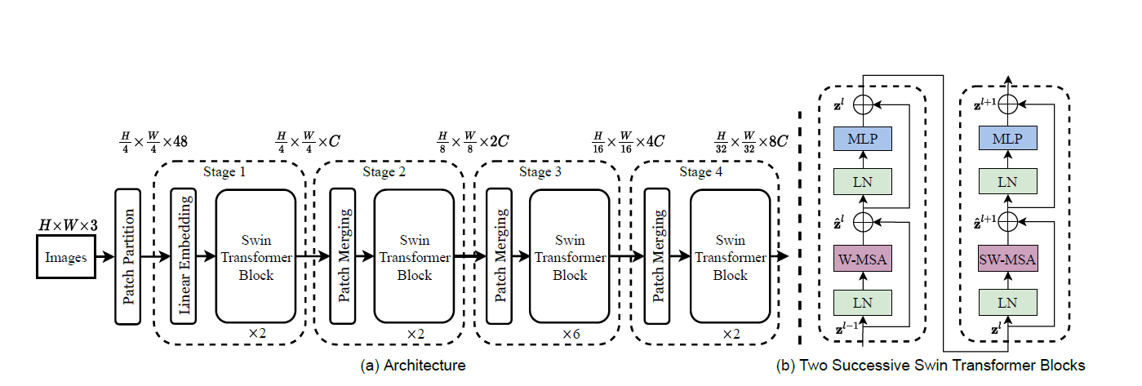
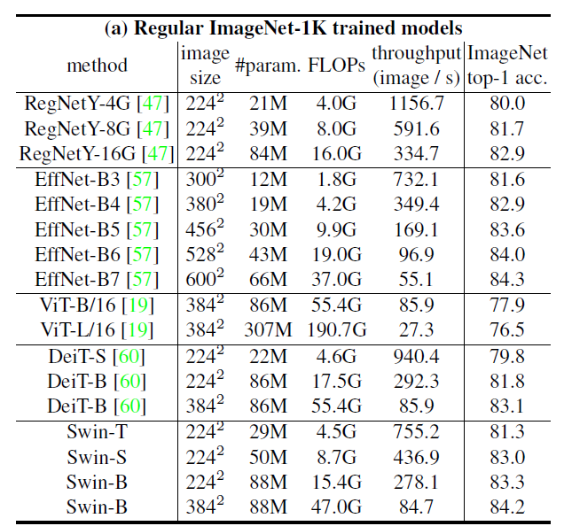
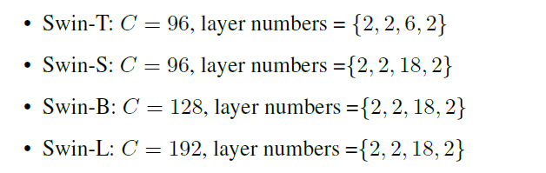
ViT Variants: Swin Transformer
Fig. 11 (a) The architecture of a Swin Transformer; (b) two successive Swin Transformer Blocks. W-MSA and SW-MSA are multi-head self attention modules with regular and shifted windowing configurations, respectively.

Slide 16
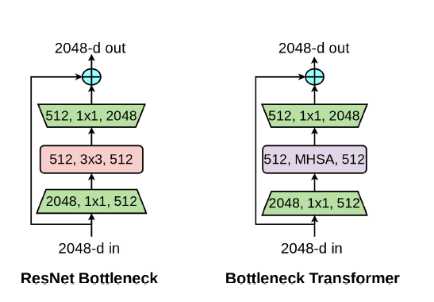
ViT Variants: BoT [7]
Why do we need self-attention?
While the convolution operation can effectively capture local information, vision tasks such as object detection, instance segmentation, keypoint detection require modeling long range dependencies.
In order to globally aggregate the locally captured filter responses, convolution based architectures require stacking multiple layers.
Self-attention is a computational primitive that implements pairwise entity interactions with a content-based addressing mechanism, thereby learning a rich hierarchy of associative features across long sequences.
Fig.12 Left: A ResNet Bottleneck Block, Right: A Bottleneck Transformer (BoT) block. The only difference is the replacement of the spatial 3×3 convolution layer with Multi-Head Self-Attention (MHSA).
A simple approach to using self-attention in vision is to replace spatial convolutional layers with the multi-head self-attention (MHSA) layer proposed in the Transformer.
Solution:
The problem of using MHSA in Computer Vision?
The memory and computation for self-attention scale quadratically with spatial dimensions, causing overheads for training and inference.
1) Use convolutions to efficiently learn abstract and low resolution feature maps from large images; 2) Use global (all2all) self-attention to process and aggregate the information contained in the feature maps captured by convolutions.
Replace only the final three bottleneck blocks of a ResNet with BoT blocks without any other changes.

Slide 17
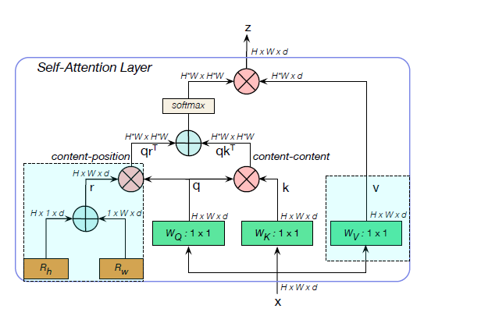
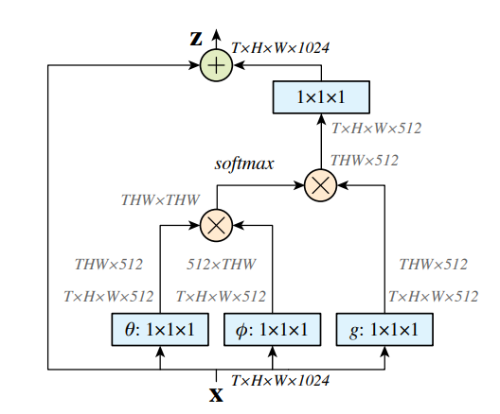
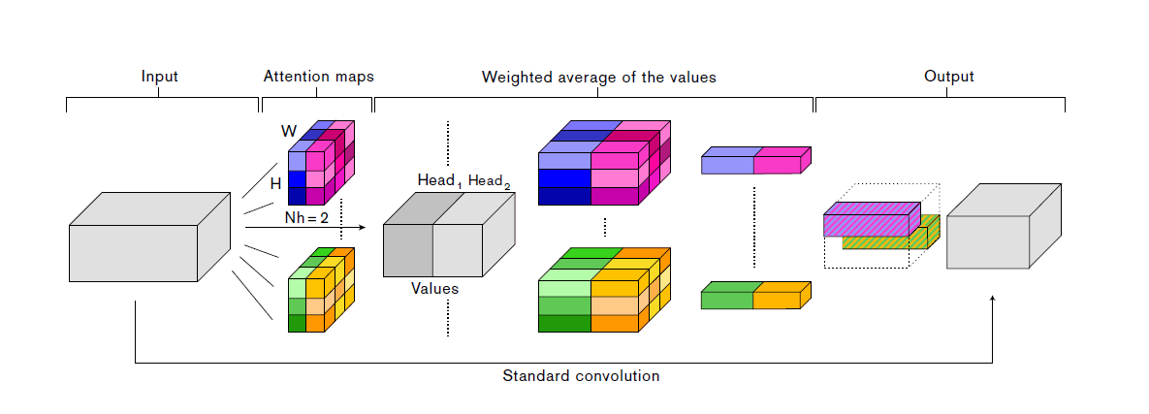

ViT Variants: BoT [7]
Fig.14 A Non-local block [9].
Fig.13 Multi-Head Self-Attention (MHSA) layer used in the BoT block.
BoT compared with Non-local and Attention-augmented convolution:
Relative Position Embedding Non-local does not have
More lightweight than Attention-augmented convolution
Fig.15 Attention-augmented convolution [10].

Slide 18
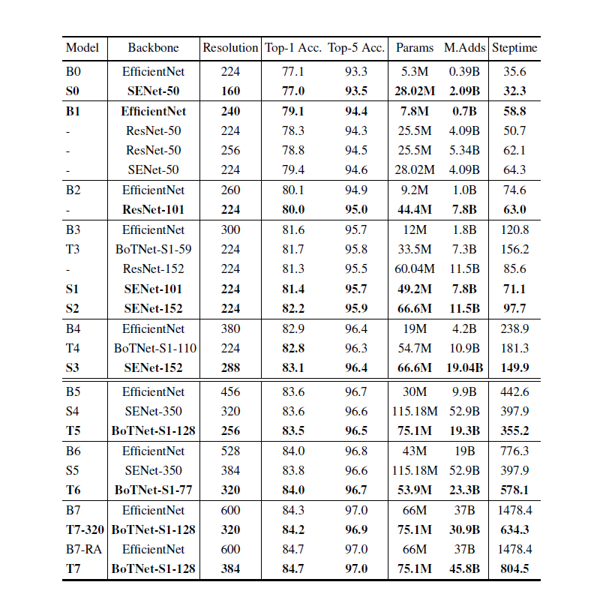
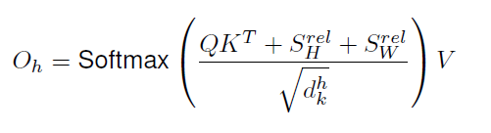
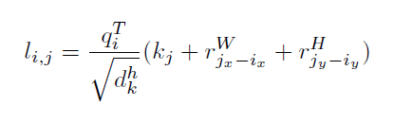
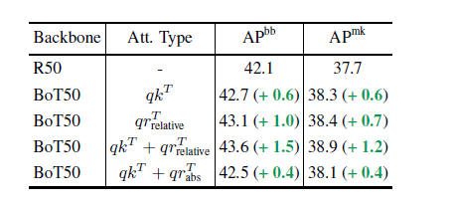
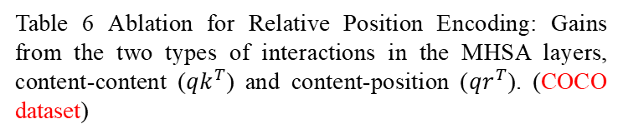
ViT Variants: BoT [7]
Table 6 Ablation for Relative Position Encoding: Gains from the two types of interactions in the MHSA layers, content-content (${qk}^{T}$) and content-position (${qr}^{T}$). (COCO dataset)
Table 5 ImageNet-1k top-1 accuracy comparison

Slide 19










My Thinking: How to apply Transformer in Computer Vision
Benefits of Convolution Block: local receptive fields, shared weights, and spatial subsampling (Good inductive bias)
Benefits of Transformer Block: dynamic attention, global context fusion, and better generalization (Larger model capacity)
Convolution Blocks
Convert to patches
$$⋯$$
Transformer Blocks
Q1: How to combine the convolution and self-attention within one model ?
Useless Features
Useful Features
Q2: How to develop a more appropriate patch embedding method ?
Hybrid model
Maybe better !?
Q3: How to largely improve parameter efficiency of the transformer block ?

Slide 20
Conclusion and Future Work
The application of Transformer in Computer Vision is not a coincidence
Convolution is a Attention or not ?
From Mathematics Aspect (operation) [12] (this paper is strongly recommended)
Perspective of effect (Visualization)
The introduction of Transformer provides a new paradigm for network architecture design
Stacking of convolutional layers (previous) + SE, SK, CBAM, CAM, Non-local (support branches, service to convolution layers)
Hybrid model (now !) replace parts of convolutional layers or create a Vision Transformer.
There is no gab between NLP and CV (The two can promote each other's development)
The usage of Transformer (BERT [13]) in CV encourages researchers to develop Self-training methods.
The usage of Self-training can greatly reduce data annotation process.
Compared with supervised learning, why semi-supervised learning and Unsupervised learning rarely catch over-fitting problems ?
Unsupervised learning (Self-training, Contrastive Learning) is a Self-learning process (Surface features are more accurate).
The learning process is more tortuous (indirectly).
A new model is coming soon ! (I got new idea from them) called Selective Mixer it is testing now!
Are we backing to MLP age? [14]
My opinion: No, More selections for model design
Notes:
[12] An empirical study of spatial attention mechanisms in deep networks. ICCV (2019) Unified self-attention mechanism theory.
[13] BERT: Pre-training of Deep Bidirectional Transformers for Language Understanding. ACL (2019) Best Long Paper Completely liberate the application of transformer in NLP.
[14] MLP-Mixer: An all-MLP Architecture for Vision. Under Review…..

Slide 21
Reference
[1] Vaswani, A., Shazeer, N., Parmar, N., Uszkoreit, J., Jones, L., Gomez, A. N., ... & Polosukhin, I. Attention is all you need. NIPS (2017).
[2] Lin, M., Chen, Q., & Yan, S. Network in network. ICLR(2014).
[3] Hendrycks, D., & Gimpel, K. (2016). Gaussian error linear units (gelus). arXiv preprint arXiv:1606.08415.
[4] Dosovitskiy, A., Beyer, L., Kolesnikov, A., Weissenborn, D., Zhai, X., Unterthiner, T., ... & Houlsby, N. An image is worth 16x16 words: Transformers for image recognition at scale. ICLR (2021).
[5] Zhou, D., Kang, B., Jin, X., Yang, L., Lian, X., Jiang, Z., ... & Feng, J. Deepvit: Towards deeper vision transformer. CVPR (2021).
[6] Liu, Z., Lin, Y., Cao, Y., Hu, H., Wei, Y., Zhang, Z., ... & Guo, B. Swin transformer: Hierarchical vision transformer using shifted windows. CVPR (2021).
[7] Srinivas, A., Lin, T. Y., Parmar, N., Shlens, J., Abbeel, P., & Vaswani, A. Bottleneck transformers for visual recognition. CVPR (2021).
[8] Hangbo Bao, Li Dong, Furu Wei, Wenhui Wang, Nan Yang, Xiaodong Liu, Yu Wang, Jianfeng Gao, Songhao Piao, Ming Zhou, et al. Unilmv2: Pseudo-masked language models for unified language model pre-training. In International Conference on Machine Learning PMLR, 2020
[9] Wang, X., Girshick, R., Gupta, A., & He, K. Non-local neural networks. CVPR (2018).
[10] Bello, I., Zoph, B., Vaswani, A., Shlens, J., & Le, Q. V. Attention augmented convolutional networks. ICCV (2019).
[11] Lin, T. Y., Dollár, P., Girshick, R., He, K., Hariharan, B., & Belongie, S. Feature pyramid networks for object detection. CVPR (2017).
Code:
https://github.com/xingshulicc/Vision-In-Transformer-Model
Welcome to star my GitHub !!!

Slide 22
My new motto
Novelty is more important than Accuracy
Thank you
Q & A

Slide 23
Relative Position Embedding: BoT
relative logits along one dimension (width): output shape is (batch_size, heads, height, width, 2 * width -1)
relative logits converted to absolute logits: output shape is (batch_size, heads, height, width, height, width)
2W - 1
0 | 1 | 2 | 3 | 4
5 | 6 | 7 | 8 | 9
10 | 11 | 12 | 13 | 14
0 | 1 | 2 | 3 | 4
5 | 6 | 7 | 8 | 9
10 | 11 | 12 | 13 | 14
W = 3
0 | 1 | 2 | 3 | 4
5 | 6 | 7 | 8 | 9
10 | 11 | 12 | 13 | 14
0 | 1 | 2 | 3 | 4
5 | 6 | 7 | 8 | 9
10 | 11 | 12 | 13 | 14
2W - 1
2W - 1
0 | 1 | 2 | 3 | 4
 | 5 | 6 | 7 | 8
9 |  | 10 | 11 | 12
13 | 14
2 | 3 | 4
6 | 7 | 8
10 | 11 | 12
0 | 1 | 2 | 3 | 4
5 | 6 | 7 | 8 | 9
10 | 11 | 12 | 13 | 14
W
W + 1

Slide 24
Relative Position Embedding: BoT
2W - 1
0 | 1 | 2 | 3 | 4
5 | 6 | 7 | 8 | 9
10 | 11 | 12 | 13 | 14
(-1, -2) | (-1, -1) | (-1, 0) | (-1, 1) | (-1, 2)
(0, -2) | (0, -1) | (0, 0) | (0, 1) | (0, 2)
(1, -2) | (1, -1) | (1, 0) | (1, 1) | (1, 2)
W = 3
(-1, -2) | (-1, -1) | (-1, 0) | (-1, 1) | (-1, 2)
(0, -2) | (0, -1) | (0, 0) | (0, 1) | (0, 2)
(1, -2) | (1, -1) | (1, 0) | (1, 1) | (1, 2)
Top-bottom distance range: [-1, 1]
Left-right distance range: [-2, 2]
Two dimensions:
If W=H:
Output shape of relative position embedding: (HW, HW)
Along one dimension

Slide 25
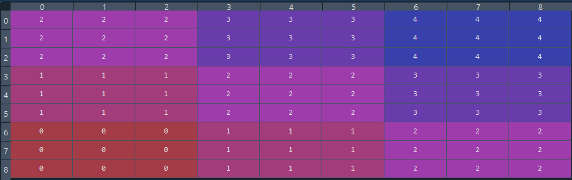


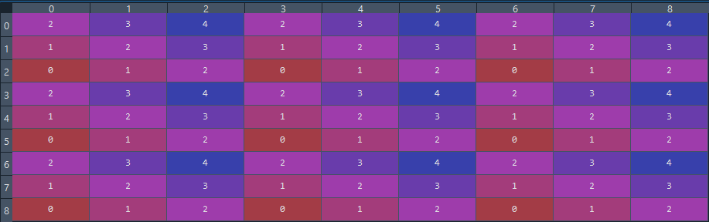


Relative Position Embedding: Swin Transformer
r_1: x axis
Relative logits indices
Relative logits shape: (2W-1, 2W-1)
Output shape: (${\text{W}}^{2}$, ${\text{W}}^{2}$)
r_2: y axis
Window size = 3

